Slide 1

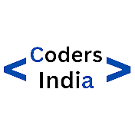



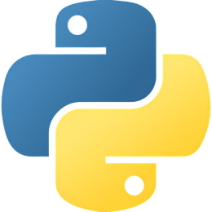





Agenda
Python Variable
Python Keyword
Python Datatypes

Slide 2

Python Variable

Slide 3


What is Python Variable ?
A Python variable is a name for a value in your program.
It stores a data value that can be of any type: integer, float, string, list, etctext

Slide 4

Variable Naming Rule....
Variable names must start with a letter (a-z, A-Z) or an underscore (_).
Python is case-sensitive.so, name, and Name would be considered different variables.
Variable names cannot be the same as Python keywords or reserved words. Examples include if, else, for, while, True, False, etc.
For multi-word variable names, use underscores to separate words (snake_case convention). For example, my_variable, total_amount, user_name.

Slide 5
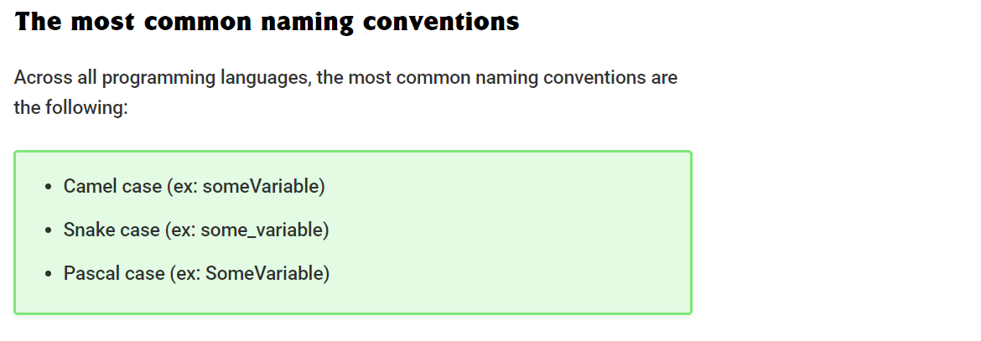

Slide 6
Python Keywords

Slide 7
What is Python Keyword ?
Python keywords are special words that already have a meaning in Python. They're like building blocks for Python's language rules. You can't use these words as names for your variables or functions. They're essential for how Python works and help control how your Python programs behave.

Slide 8
Lets find Python keywords
keword list
import keyword
print(keyword.kwlist)
['False', 'None', 'True', 'and', 'as', 'assert', 'async', 'await', 'break', 'class', 'continue', 'def', 'del', 'elif', 'else', 'except', 'finally', 'for', 'from', 'global', 'if', 'import', 'in', 'is', 'lambda', 'nonlocal', 'not', 'or', 'pass', 'raise', 'return', 'try', 'while', 'with', 'yield']

Slide 9
Python Datatypes

Slide 10
What is Python Datatypes ?
In Python, a data type specifies the kind of value stored in a variable. It defines what type of information the variable can hold.

Slide 11

None
int
float
str
Datatype
bool
list
tuple
set
dict

Slide 12

Thank You
For Your Attention

